Slide 1
Artificial Intelligence

Slide 2
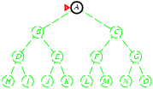
Depth-first Search
Expand deepest unexpanded node Goes to the deepest level of the search tree where there are no further successors
Implementation:
use frontier as a Stack, LIFO
Put the expanded node at the front of the frontier Frontier = A

Slide 3
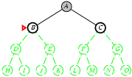
Depth-first Search
Expand deepest unexpanded node
Check if A is goal, it is not, expand A, remove A
Frontier = B,C

Slide 4
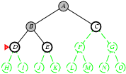
Depth-first Search
Check if B is goal, it is not, expand B, remove B
Frontier = D,E,C

Slide 5
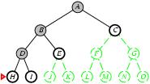
Depth-first Search
Check if D is goal, it is not, expand D, remove D
Frontier = H, I, E, C

Slide 6
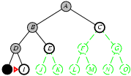
Depth-first Search
Both H and I has not successors so remove them if it is not goal
Frontier = E, C

Slide 7
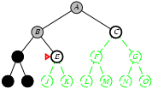
Depth-first Search
Check if E is goal, it is not, expand E, remove E
Frontier = J, K, C

Slide 8
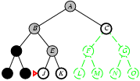
Depth-first Search
J and K do not have successors neither is any of them goal so remove them from frontier one by one
Frontier = C

Slide 9
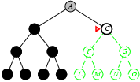
Depth-first Search
Check if C is goal, it is not, expand C, remove C
Frontier = F, G

Slide 10
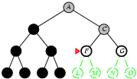
Depth-first Search
Check if F is goal, it is not, expand F, remove F Frontier = L, M, G

Slide 11
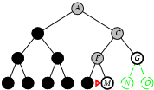
Depth-first Search
Both L, M are not goal, neither they have any successor
Remove L, M from frontier
frontier = G
Check if G is goal, it is
The search terminates

Slide 12
Properties of Depth-first Search
Complete? No: fails in infinite-depth spaces, spaces with loops
Complete in finite state space
Modify to avoid repeated states along path
Optimal? No
Time? O(b^{m}) terrible if m is much larger than d

Slide 13
Uniform-cost Search
Expands a node with the lowest path cost
UCS is uninformed search algorithm and use BFS technique
Find the least cost path from start to goal in weighted graph
Dijkstra’s Algo
Guarantees optimal solution if step costs are non negative
Explores nodes with lowest cumulative cost first
Equivalent to breadth-first if all step costs are equal
Use a priority queue to manage nodes
Implementation:
frontier = queue ordered by path cost (priority queue)

Slide 14
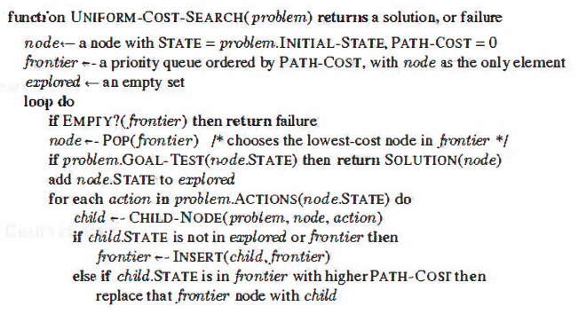
Uniform Cost search

Slide 15
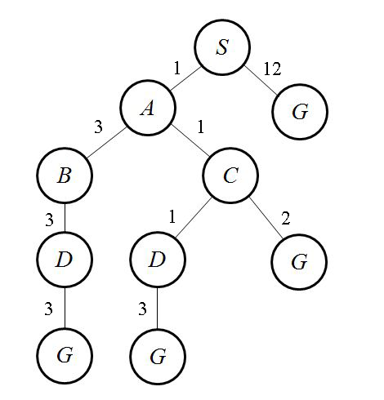
Uniform Cost search
Expand the least-cost unexpanded node
Implementation: frontier is a queue ordered by path cost
Equivalent to breadth-first if step costs are all equal

Slide 16
Uniform Cost search
S
1
12
frontier (P.Q)
S 0
A 1
G 12
A
G
3
1
B
C
2
3
1
D
D
G
3
3
G
G

Slide 17
Uniform Cost search
S
1
12
A
G
frontier (P.Q)
S 0
A 1
C 2
B 4
G 12
3
1
B
C
2
3
1
D
D
G
3
3
G
G

Slide 18
Uniform Cost search
S
1
12
A
G
frontier (P.Q)
S 0
A 1
C 2
D 3
G 4
B 4
G 12
4
1
B
C
2
3
1
D
D
G
2
3
G
G

Slide 19
Uniform Cost search
S
1
12
A
G
frontier (P.Q)
S 0
A 1
C 2
D 3
G 4
B 4
G 6
G 12
3
1
B
C
2
3
1
D
G
D
G
3
3
G
G

Slide 20
Uniform-cost Search
The search is guided by the path cost instead of depths, so complexity cannot be easily characterized by b and d
Let C * is the cost of the optimal solution and every action cost is at least ε
Complete? Yes, if step cost ≥ ε, a positive number
Optimal? Yes – nodes expanded in increasing order of g(n)
Time? # of nodes with g ≤ cost of optimal solution, O(b^{[C*/ ε]})
Space? # of nodes with g ≤ cost of optimal solution, O(b^{[C*/ ε]})

Slide 21
Uniform-cost Search
Time? # of nodes with g ≤ cost of optimal solution, O(b^{[C*/ ε]})
C*: The cost of the optimal (cheapest) solution.
^{ε} : The minimum cost of any single edge. This must be a positive value > 0) to prevent the algorithm from getting stuck in infinite loops of zero-cost steps.
b: The branching factor (average number of children per node).

